Slide 1
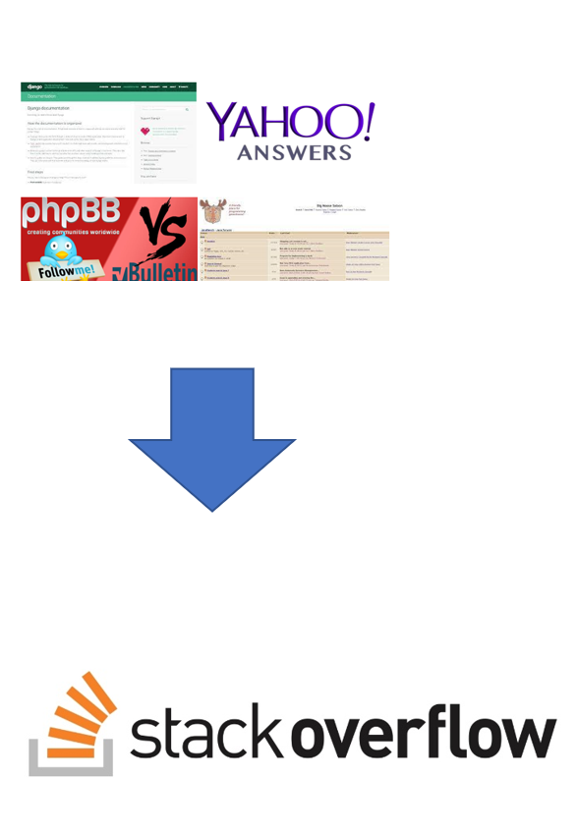
SOLUTIONS INFINITY
(Stack Overflow Clone)

Slide 2
AGENDA
1
2
3
ABSTARCT
REQUIREMENTS
FEATURES AND HIGHLIGHTS
4
5
6
TECHNICAL ASPECTS
CHALLENGES FACED
SCREENSHOTS
7
8
9
FUTURE ENHANCEMENT
CONCLUSION
REFERENCES

Slide 3
ABSTRACT
Earlier Developers relied on mailing lists, forums, and online communities
Solutions Infinity to replicate the core functionality of the popular Q/A platform, Stack Overflow.
Features including ask question, post answer, use tags, upvotes delete questions and answers
Solutions Gpt included which uses chat gpt api

Slide 4
REQUIREMENTS
USER REGISTRATION AND AUTHENTICATION
QUESTION AND ANSWER SYSTEM
VOTING
NOTIFICATIONS
TAGGING AND CATEGORIZATION
REPUTATION SYSTEM
SEARCH FUNCTIONALITY

Slide 5
FEATURES AND HIGHLIGHTS
01
02
03
User register with tags and get feeds based on those tags
User can ask new question by including tags
User can search question and view all solutions,also comment on question.

Slide 6
04
05
06
07
User can add solution,it will notify the Questioner.
User can utilize solutions Gpt which is Chat Gpt API.
Users can upvote solutions, Reputation will provided.
Admin can visualize performance of users and system

Slide 7
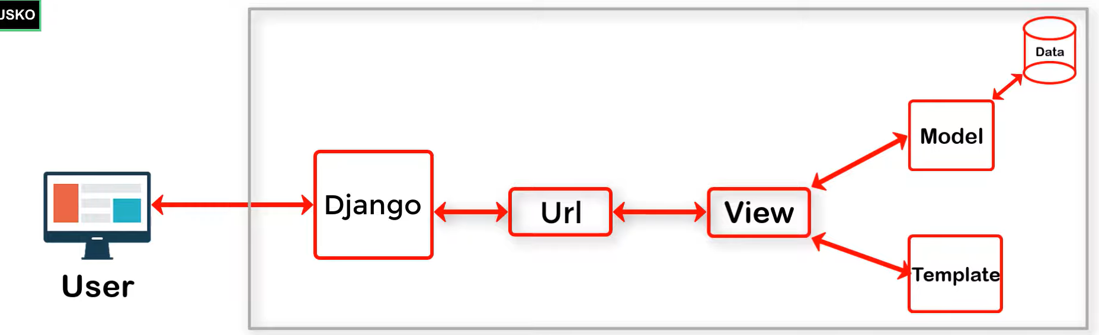
ARCHITECTURE
A webservice has layout,data,business logic
Django Follows MVT Architecture(Model,View,Template)

Slide 8
THIRD PARTY LIBRARIES
Django-Jazzmin
Matplotlib
Open AI
Charts JS

Slide 9
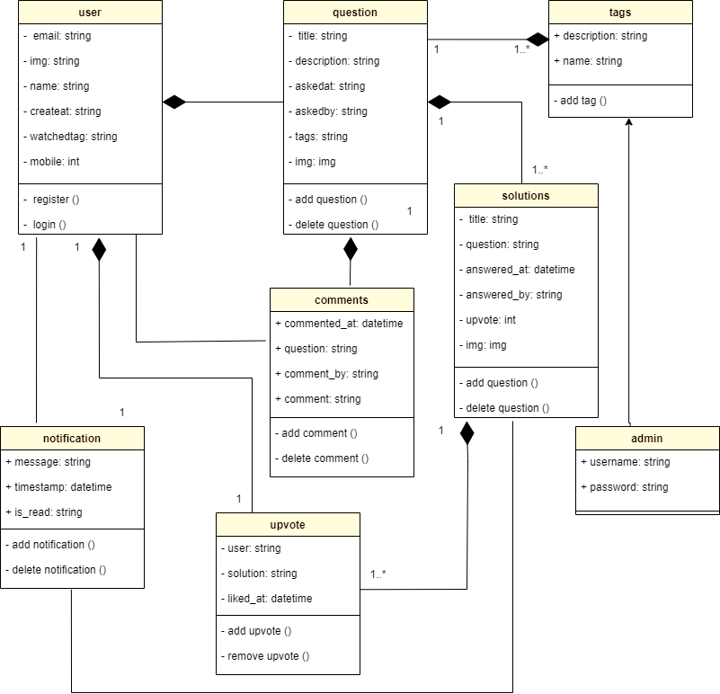
CLASS DIAGRAM

Slide 10
CHALLENGES FACED
implementing notification system.
Integrating Chat GPI API.
Admin Visualization

Slide 11
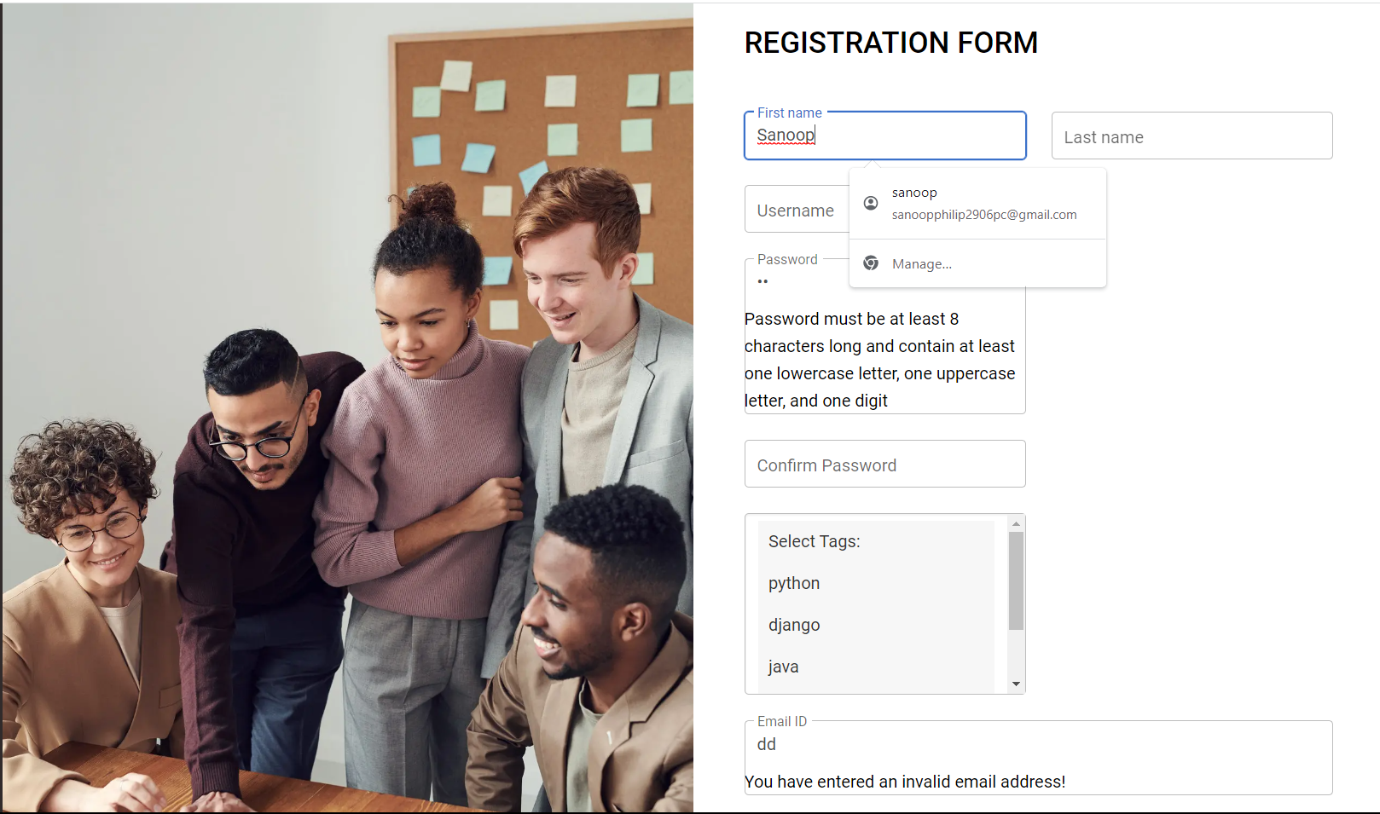
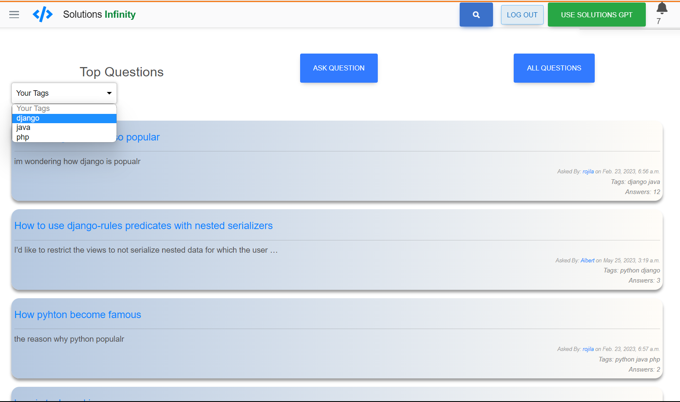
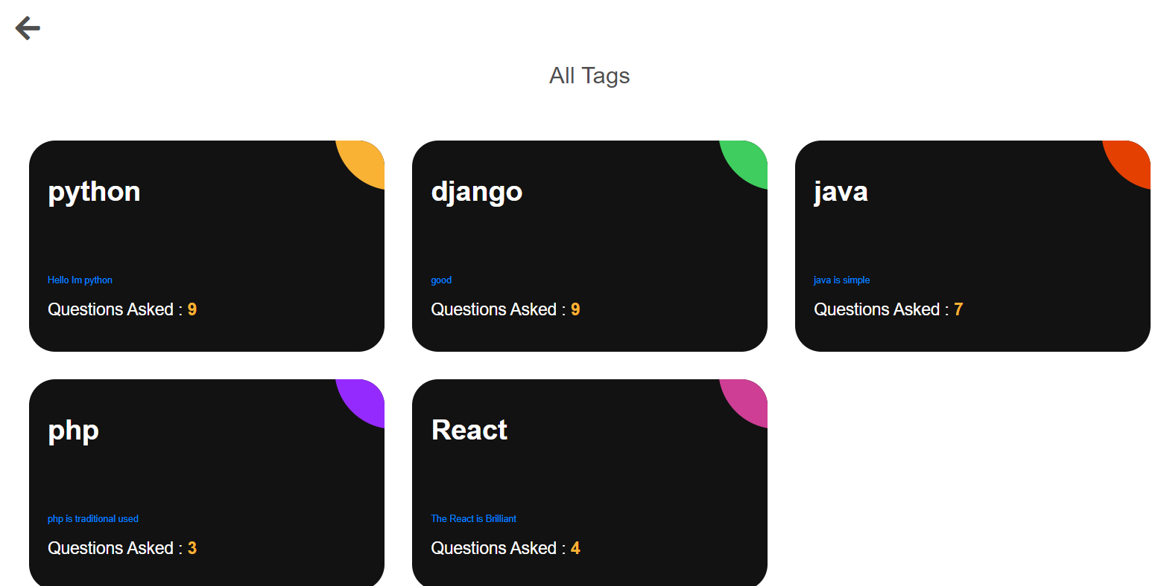
SCREENSHOTS
REGISTRATION
USER HOME PAGE
ALL TAGS PAGE

Slide 12
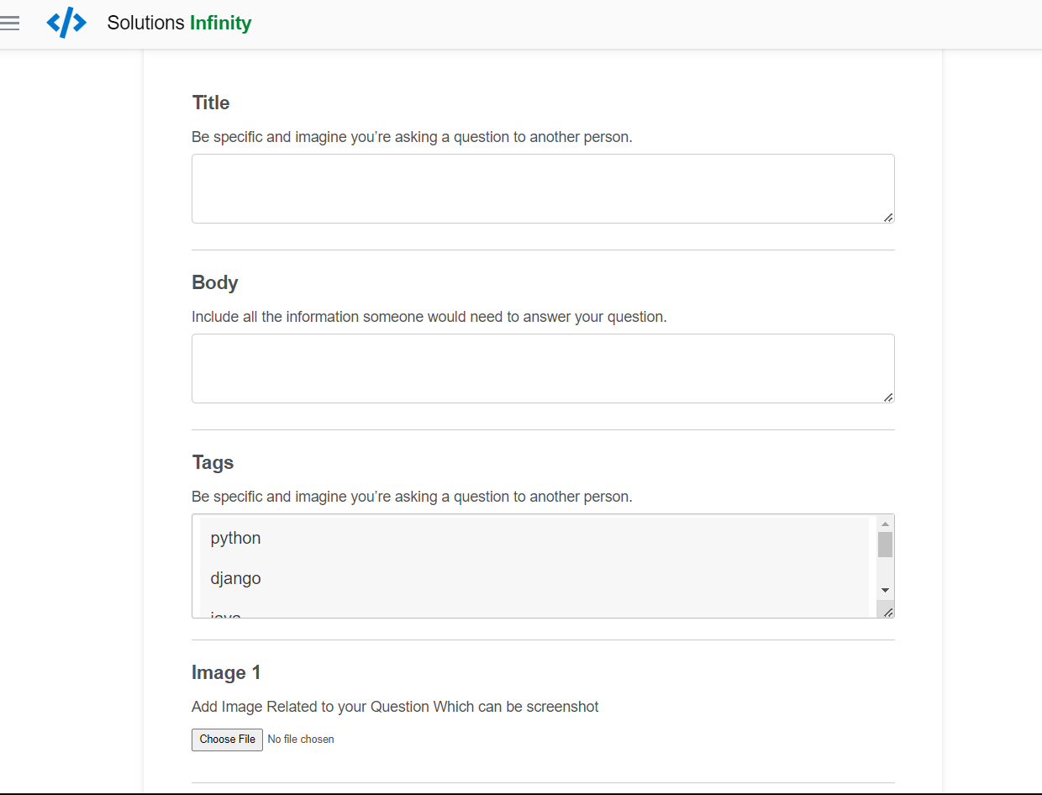
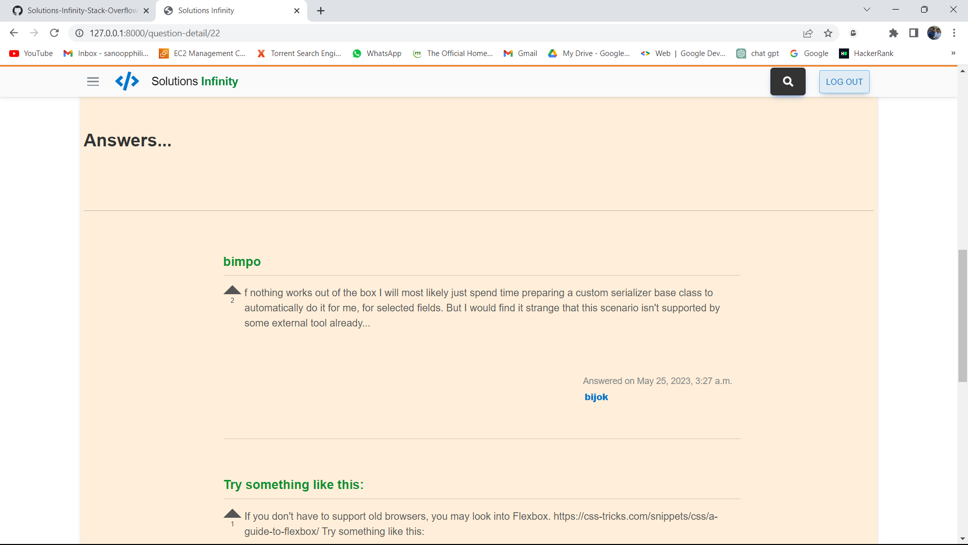
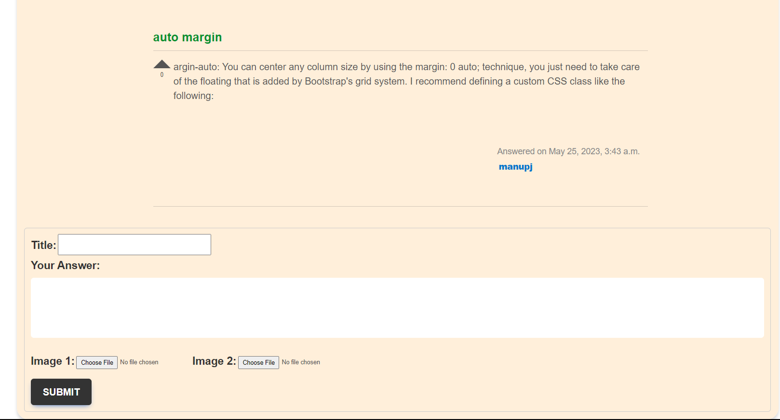
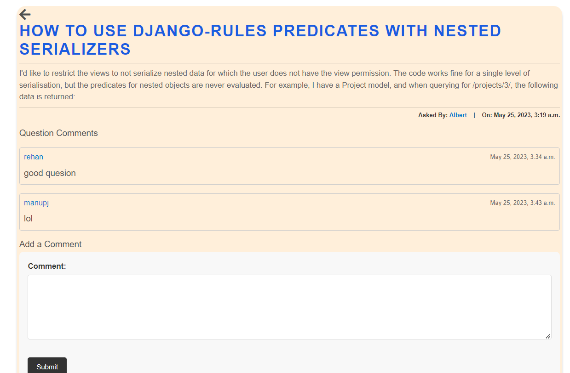
ASK QUESTION PAGE
QUESTION DETAIL PAGE

Slide 13
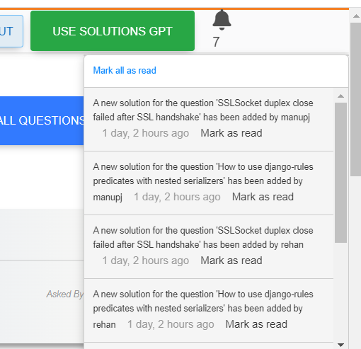
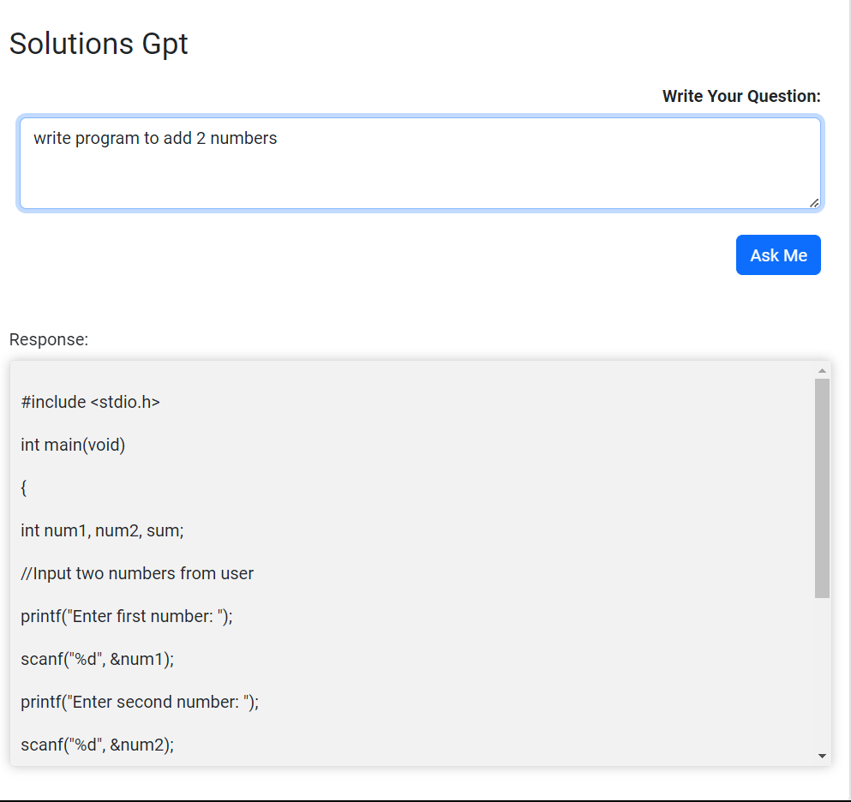
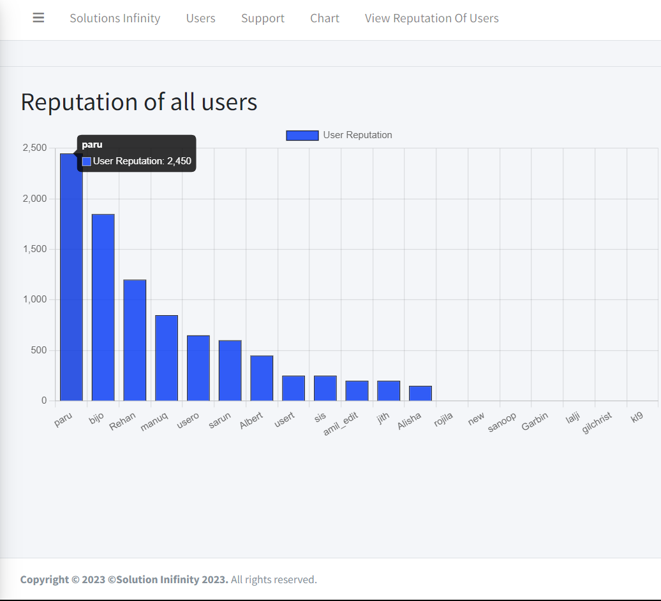
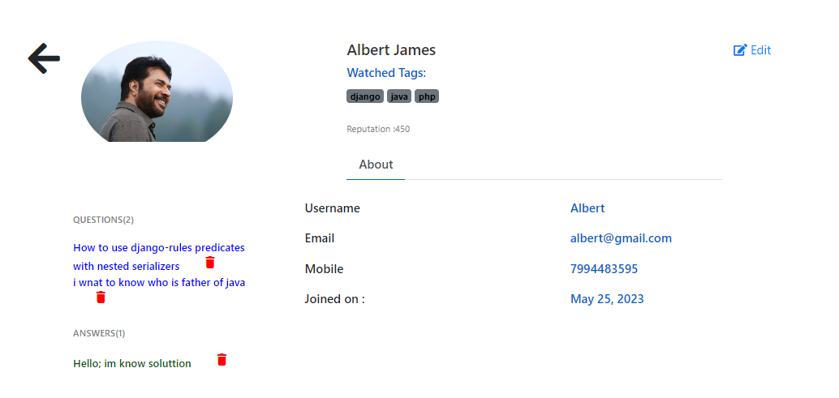
NOTIFICATION
SOLUTIONS GPT
ADMIN VISUALIZATION
USER PROFILE VIEW

Slide 14
FUTURE ENHANCEMENT
Chat option between users.
Edit question and answer option.
Email Alerts .
Social Media Integration.
Machine Learning and AI Integration

Slide 15
CONCLUSION
Constructing a Stack Overflow clone can be a great way to build a healthy community of knowledge-sharing and problem-solving. You can create a platform where users can ask questions, receive answers, and engage in discussions about programming, software development, and other technical issues by reproducing the basic operations and features of Stack Overflow.

Slide 16
REFERENCES
Templates-https://github.com/RugvedB/StackoverflowClone/tree/master/stackoverflow/main
And: https://mdbootstrap.com/
Chat Gpt- https://chat.openai.com/
Stack Overflow - https://stackoverflow.com/
Jazzmin Documentation - https://django-jazzmin.readthedocs.io/configuration/
Chat gpt api documentation - https://platform.openai.com/docs/apireference/introduction
Chartjs - https://www.chartjs.org/docs/latest/charts/bar.html

Slide 17
THANK YOU

